Slide 1
COMMUNITY SERVICE

Slide 2
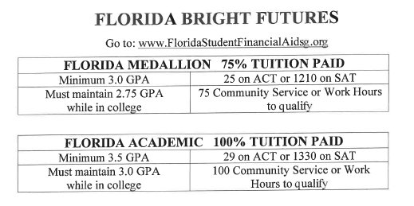
Using those community Service hours for Bright Futures Scholarship qualifications??
AICE Diploma + 100 Service Hours = Bright Futures Academic Level Scholarship
OR

Slide 3
Students must identify a social or civic issue and develop a plan for personal involvement. This plan does not have to be turned in, but students may be asked to discuss it with their College/Career Advisors.
Volunteer hours must be completed at a non-profit or for-profit organization addressing a social or civic issue that interests the student.
For volunteer hours, the student must be supervised by the organization’s employee who is not related to the student.
Hours must be completed after the student’s promotion to grade 9 and before high school graduation.
All forms should be turned in to the Student Success Center BEFORE Senior graduation.
Students should expect to be asked about their volunteer experience by a College/Career Advisor. **Add these experiences to your resume.
Only the hours of direct service to the organization are to be documented on the log sheet. Do not include travel time or break time.
Speak with your College/Career Advisor with any additional questions.

Slide 4
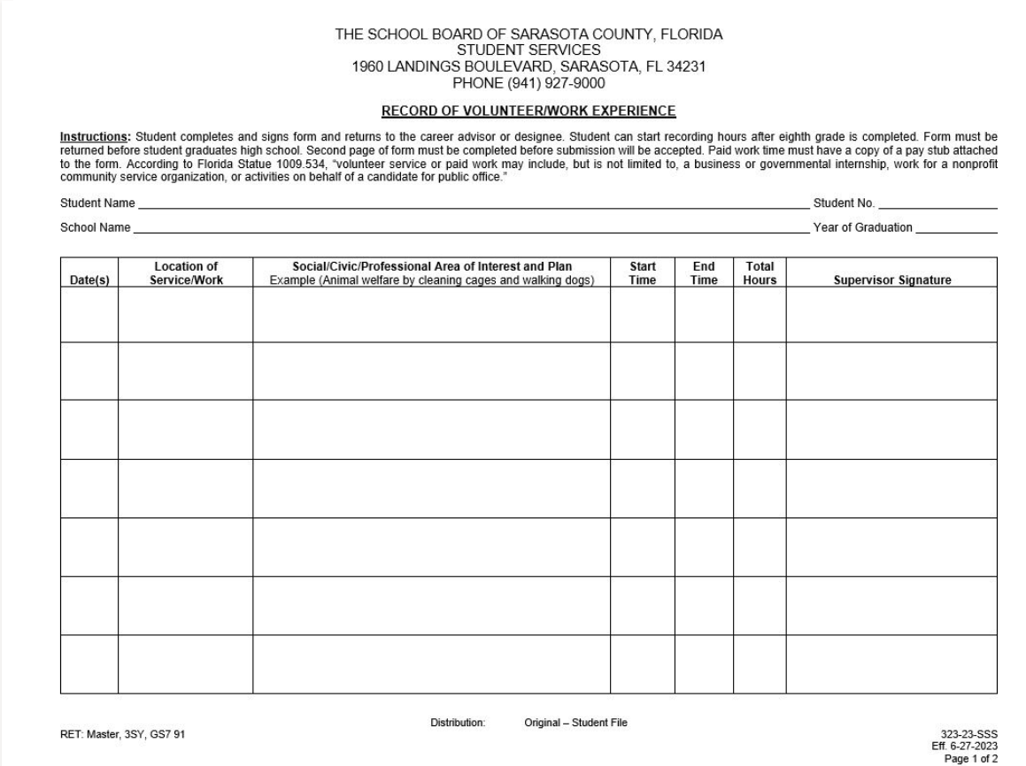
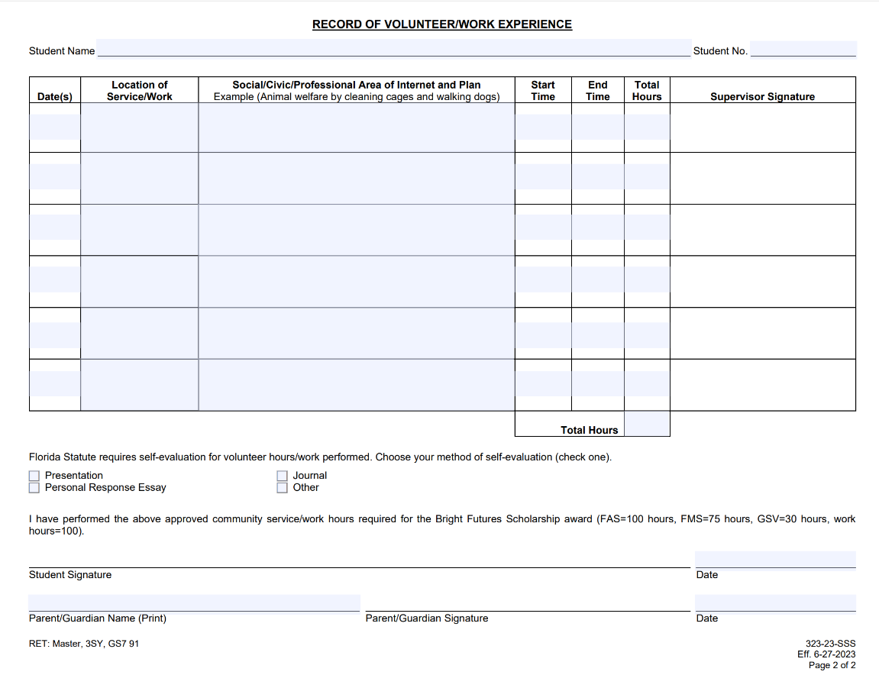
FRONT
DO NOT FORGET:
One day per line
Supervisor MUST sign
Total your hours and write it in
You sign and your parents sign
Self-reflect on your WHY
BACK

Slide 5
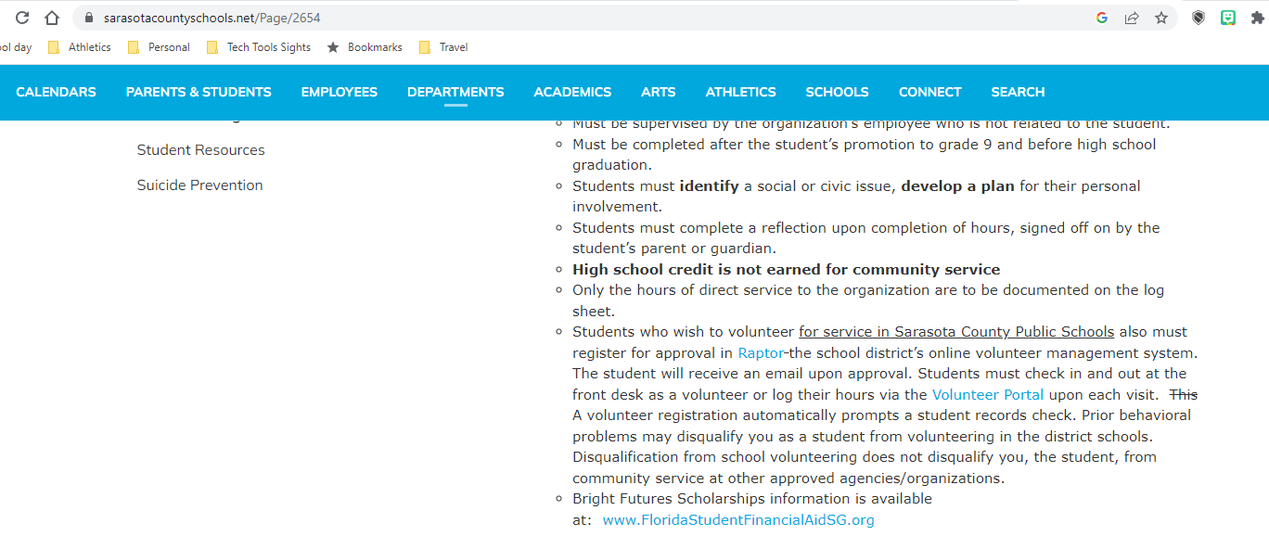
www.SarasotaCountySchools.net – Parents & Students – Community Service (HS)
Helping a Sarasota County Schools teacher
or coach for volunteer hours??

Slide 6
What is acceptable
Volunteer service may include but is not limited to a business or governmental internship, work for a nonprofit community service organization, or activities on behalf of a candidate for public office.
Volunteer service performed during a religious service or event
Volunteer or work hours within and outside of Sarasota County
Volunteering for an organization that is not a 501c3
What is not accepted
A parent cannot supervise and/or sign as supervisor for their own child’s work or community service
Students cannot use service or work done to earn high school credits
More than 8 hours of volunteer time within a 24-hour period
Additional Information
Students who wish to volunteer for service in Sarasota County Public Schools also must register for approval in Raptor the school district’s online volunteer management system. The student will receive an email upon approval. Students must check in and out at the front desk as a volunteer or log their hours via the Volunteer Portal upon each visit. A volunteer registration automatically prompts a student records check. Prior behavioral problems may disqualify you as a student from volunteering in the district schools. Disqualification from school volunteering does not disqualify you, the student, from community service at other approved agencies/organizations.
Pre-approval of hours is no longer required

