Slide 1
WELCOME PARENTS & STUDENTS
CLASS OF 2027!

Slide 2
Agenda
Welcome
Mr. Jones, SHS Principal
AICE Program Overview
Mrs. Harshman, AICE Coordinator
AICE Application Process
Mrs. Harshman, AICE Coordinator
MaST at SHS
Mr. Harshman
AICE and Mast Students
Mrs. Anderson
Assistant Principal – AICE
Mrs. Albanese
11th and 12th grade AICE student counselor
Mrs. Conti
9th and 10th grade AICE student counselor
Mrs. Renner
AICE Administrative Assistant

Slide 3
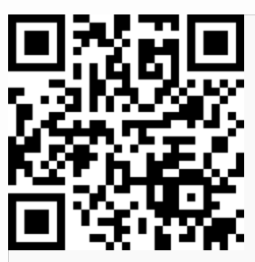
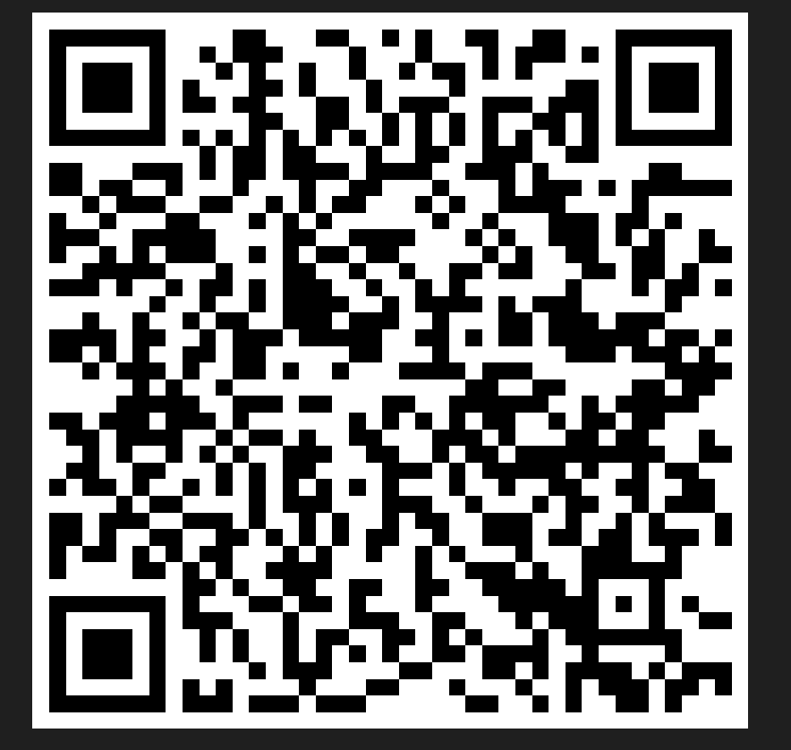
Advanced International Certificate of Education (AICE)
www.shsaice.com
AICE Application – Get notified when the AICE application is available
Sarasota High School

Slide 4
What is AICE?
Advanced International Certificate of Education
The Cambridge AICE diploma is an international curriculum and examination program that prepares students to enter college, provides skills needed to be successful in college and thereafter, and allows students to earn college credits and scholarships while in high school.

Slide 5
WHAT IS AICE?
The University of Cambridge writes the course curriculum, trains our teachers, and grades the student exams.
The textbooks come from Cambridge and are aligned with the exam expectations.
The University of Cambridge International Examinations is the world’s largest provider of international education programs. It was founded in 1858.
There are now 10,000 Cambridge schools around the world in over 160 countries.
Notes:
https://slidetodoc.com/what-everyone-ought-to-know-about-the-cambridge/

Slide 6
Why Should I Consider AICE?
Global Perspectives
College Readiness
Scholarship Opportunities
Breadth and Depth of Learning
International Recognition
Flexibility
Notes:
https://www.flvs.net/online-courses/aice
AICE is more flexible than IB, allowing students greater choice in the balance of classes they select.
If, for instance, a student wants to take four credits in languages and only one in each of the other required categories, that's completely OK! AICE also demonstrates more concern over the amount of time students spend on busywork, remaining committed—by its own declaration—to helping students learn without excessive amounts of homework.
On the other hand, AICE courses are more specific in their focuses than AP classes are. AP classes are known for their broad and shallow approach, whereas AICE classes narrow in on particular subjects and drill deep.
In a lot of ways, AICE seems to be a happy medium between these two other college preparatory programs. Plus, according to studies by the University of Florida and University of Virginia, it also appears that AICE Diploma students earn higher GPAs in college than AP or IB students do
https://blog.prepscholar.com/aice-diplomas

Slide 7
Cambridge courses provide opportunities for students to explore and make judgements about global issues of relevance and importance to their own lives.
AS/A Global Perspective and Research course (REQUIRED):
Student will define a global problem, reflect, and propose a plan of action.
They will develop research skills that will enable them to obtain information, evaluate its reliability, and use the evidence gathered to construct their own arguments and lines of reasoning.
Written exam, essay, team project (presentation and reflective paper), and research report

Slide 9
Students who earn the AICE Diploma (+ 100 volunteer hours) qualify for Bright Futures, regardless of GPA or SAT/ACT scores
Bright Futures will pay 100% of a student’s tuition if they attend a public University in the state of Florida!

Slide 10
AICE Courses promote critical thinking skills and higher order thinking skills needed and desired in the 21st century workforce.
No longer the old style of read and regurgitate, memorization only
Teachers show the students how to think, not what to think
AICE exams are designed for students to apply, analyze, synthesize, and evaluate information

Slide 11
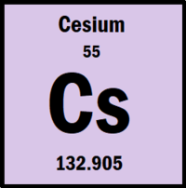
Breath and Depth of Knowledge
AP Chemistry Exam, 2008

Slide 12
Breath and Depth of Knowledge
AICE Chemistry Exam, June 2012
In which species are the numbers of proton, neutrons, and electrons all different?
In which species are the numbers of proton, neutrons, and electrons all different?
p⁺ = 9
e⁻ = 10
nº = 10
p⁺ = 11
e⁻ = 10
nº = 12
p⁺ = 12
e⁻ = 10
nº = 12
p⁺ = 5
e⁻ = 5
nº = 6

Slide 13
The Cambridge AICE curriculum is widely used by countries all over the world (160 countries)
The AICE Diploma offers an international metric for all students taking the AICE exams
Each exam is given on the same day around the world. All students in the world take the exact same exam. Passing the exam demonstrates continuity of knowledge and calibrates the AICE diploma as a universal standard of knowledge.

Slide 14
=
We offer a choice of 33 AS and A level subjects. We can offer them in almost any combination.
This flexibility means we can build an individualized curriculum, and learners can choose to specialize in a particular subject area of study a range of subjects.
Cambridge International A Level is typically a two-year course, and Cambridge International AS Level is typically one year. Some subjects can be started as a Cambridge International AS Level and extended to a Cambridge International A Level.

Slide 15
AICE at SHS
53 Pre-AICE/AICE teachers
≈ 900 AICE Students
Courses Offered: Pre-AICE → AICE AS Level → AICE A Level
In 2022, 157 Seniors earned the AICE Diploma – 83% of seniors in AICE
This year, 183 seniors are attempting to earn the AICE Diploma
In June 2022, SHS students passed 1347/1608 AICE Exams (84% pass rate over all subject area)

Slide 16
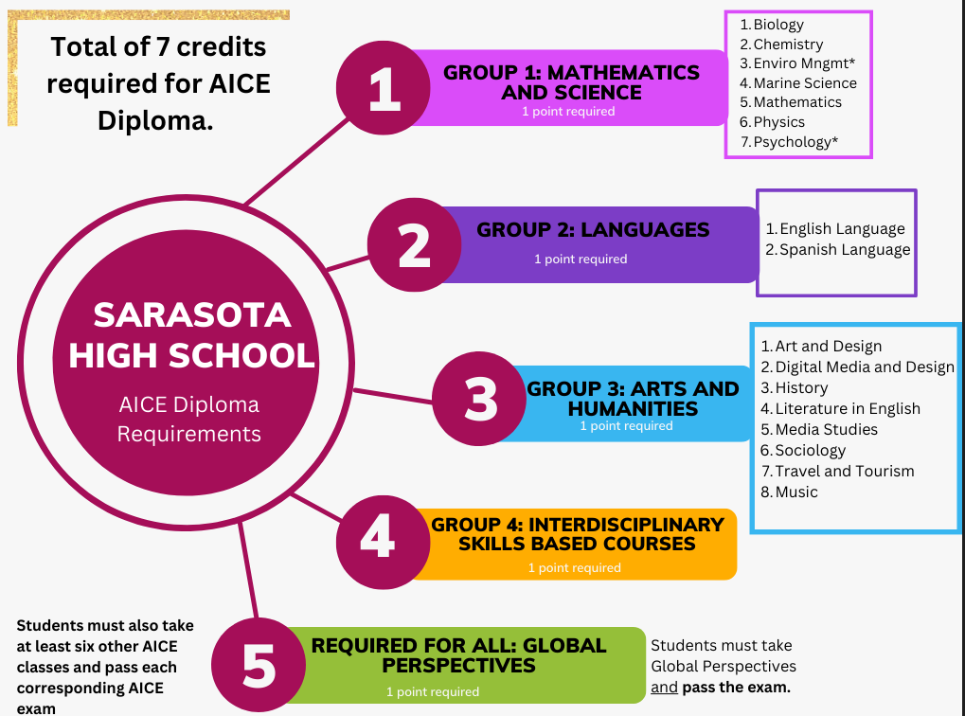

Slide 17
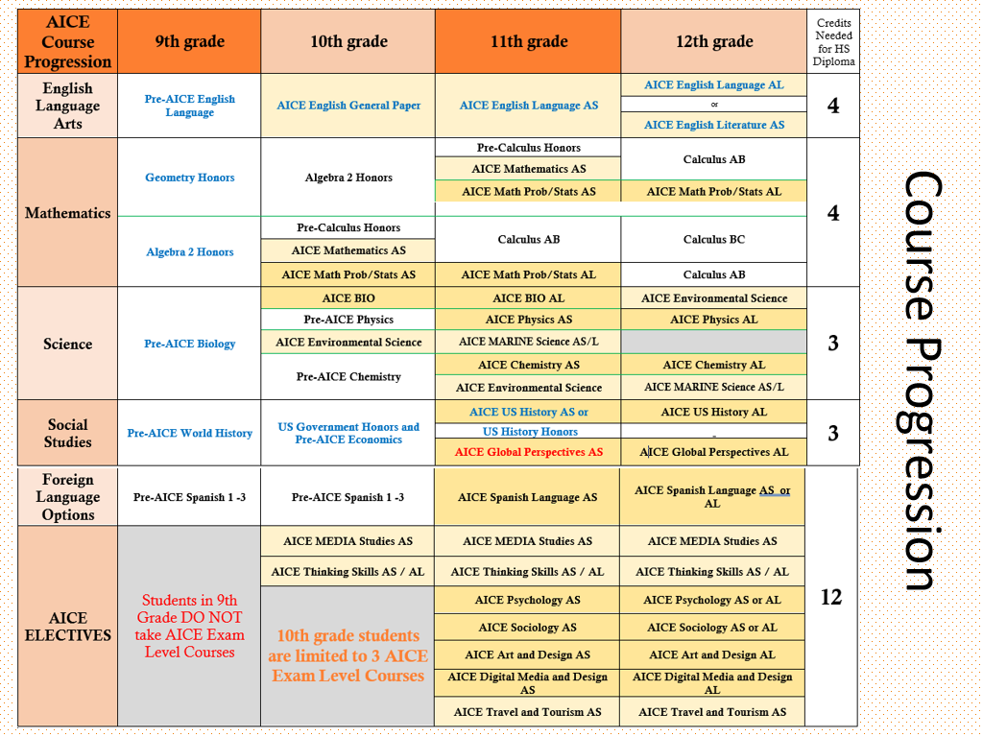
Pre-AICE Courses for 9th Graders
Pre-AICE Biology*
Pre-AICE English Language*
Pre-AICE World History*
Honors Math* (Algebra 1, Geometry or Algebra 2)
Remaining 3 classes are electives.
*We suggest foreign language. There is also a Pre-AICE PE class that fulfills the HOPE graduation requirement.

Slide 18
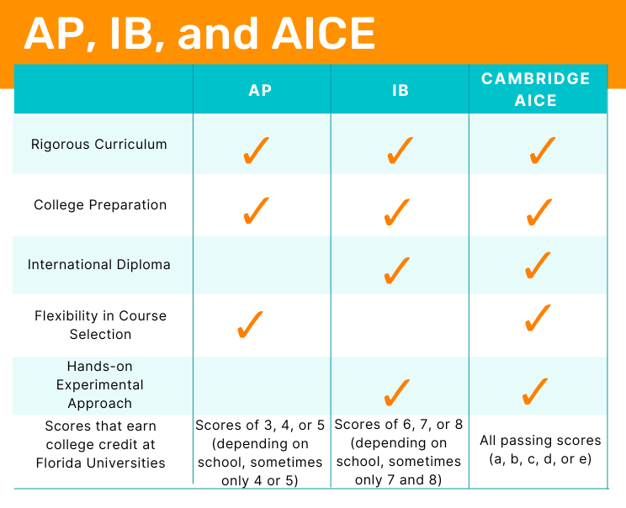
Notes:
https://www.youtube.com/watch?v=pbb5F7SFZMU

Slide 19
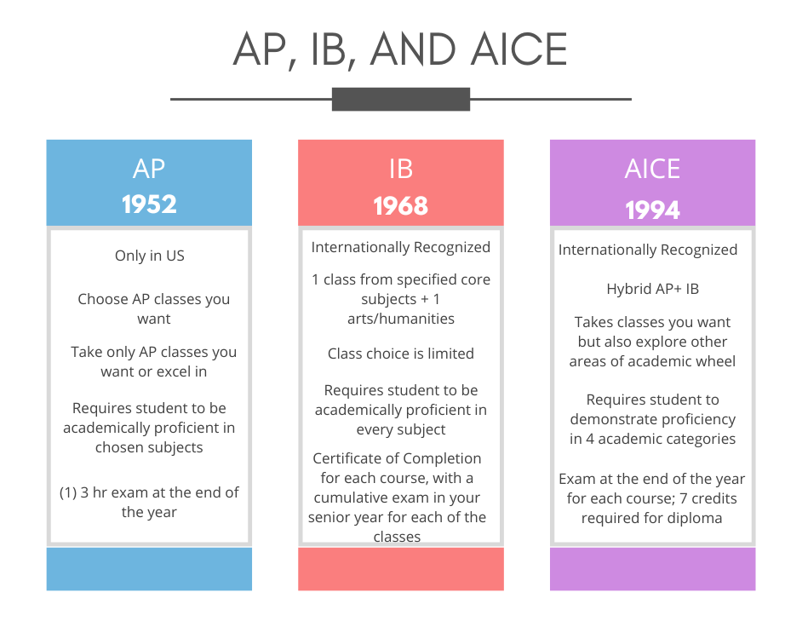
Notes:
https://www.youtube.com/watch?v=pbb5F7SFZMU

Slide 20
Can I do both AICE and MaST at the same time?
Can I do sports while taking AICE classes?
What if I don’t pass the AICE exam at the end of the year?
Will I have hours of homework each night?
Will I have classes with only other AICE students?
What is the difference between magnet and school choice?

Slide 21
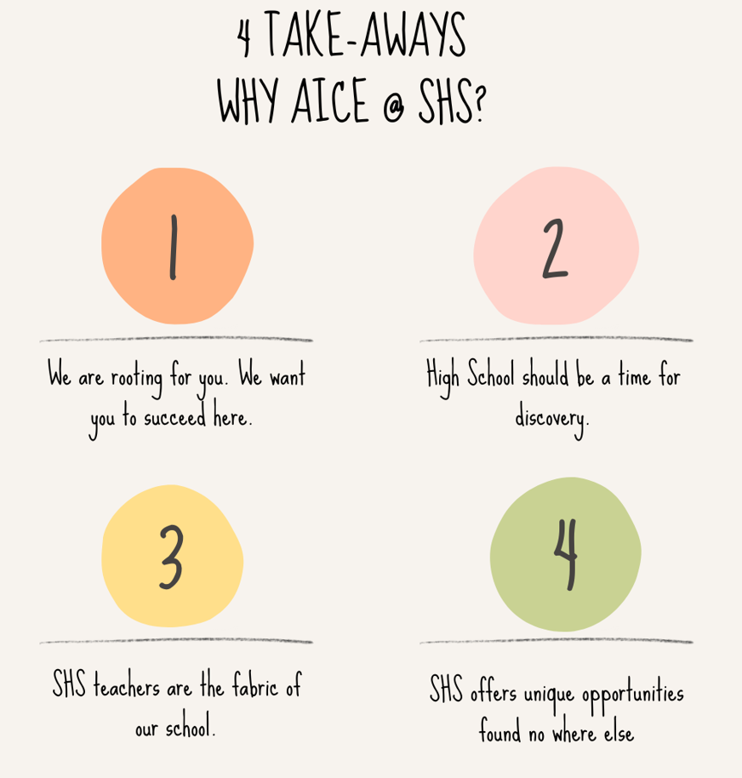
Notes:
https://www.youtube.com/watch?v=87BJCkiEjuE

Slide 22
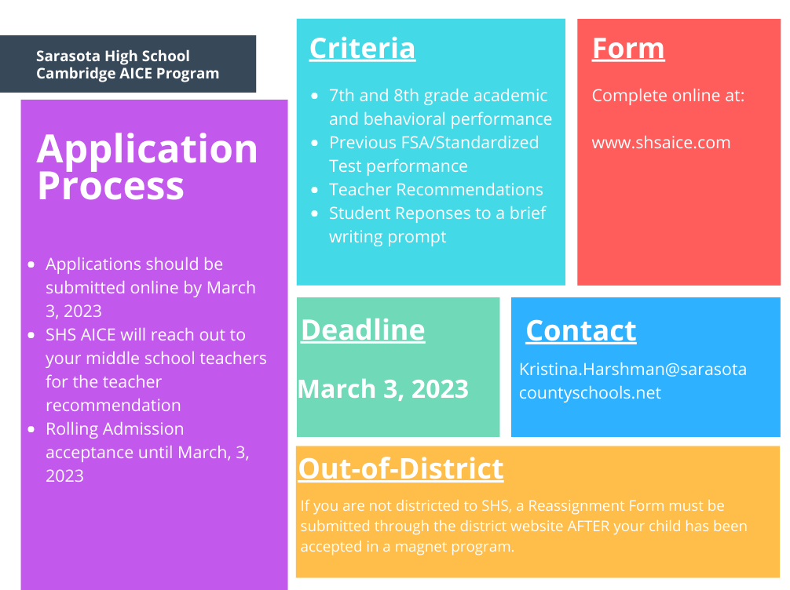

Slide 23
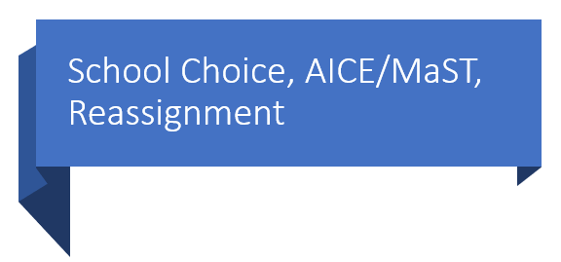
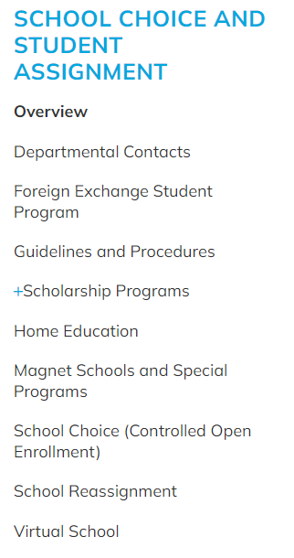
If your child gets into School Choice AND AICE/MaST, you must notify the School Choice office that you decline the school choice option so they take you off their list (by April).
Reassignment Form: If you are not districted to SHS, a Reassignment Form must be submitted through the district website AFTER your child has been accepted in a magnet program or school choice. (Parent/Student Tab → Reassignment link)
New Enrollment (Registration) Application: If you are new to a Sarasota County Public school, you must fill out a New Enrollment Application.
Re-registration – all students who attended a Sarasota County School the previous year
Jennifer Mikulski @ SHS handles all new incoming students to SHS

Slide 24
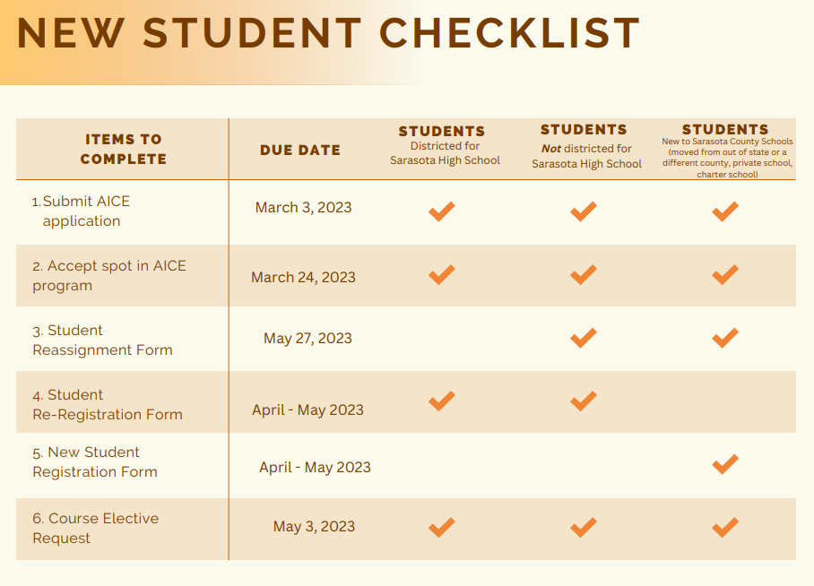

Slide 25
Important Dates
February
Feb. 1 – School Choice applications open
Feb 28 – School Choice applications close
March
March 1 – Reassignment Forms available
March 3 – AICE Applications due
March 24 – student must notify SHS AICE of acceptance or declining spot
April
April 11th – School Choice notifications go out
April 18th – Deadline to accept school choice
May
May 27th – Reassignment Forms MUST be submitted

Slide 26
Cambridge University
This Photo by Unknown Author is licensed under CC BY-SA
Thank you for your interest in the Cambridge University AICE program at Sarasota High School. We are honored to be able to offer an advanced, competitive, and unique opportunity for students to earn college credits, and scholarship opportunities.

Slide 28
Basic MaST Research Description
MaST Research Institute – Founded in 1995
Research in Math, Sciences, and Engineering
Students will:
be taught the research process the 1st year by teachers with research experience – hands-on experiments galore!
2nd Year – delve into scientific literature and gain writing/presentation skills in the AP Seminar course. Design your 3rd year project.
3rd-4th year - conduct independent research projects guided by community and faculty mentors
Present research to community via science fair and other competitions.
Gain extra knowledge through real world research experience.

Slide 29
Why Join MaST?
YOU get to choose what you study!
Take something you like or are passionate about and do something about it!
You will learn how to do research from people who have been there before
The teachers have college research experience…and one of us graduated from MaST!
Provides a special edge when applying for college
Potential of 6 hours of college credit & chance for Prestigious AP Capstone Certificate
…and YES, you CAN be in both MaST and AICE! In fact, almost all MaST students are also AICE students!

Slide 30
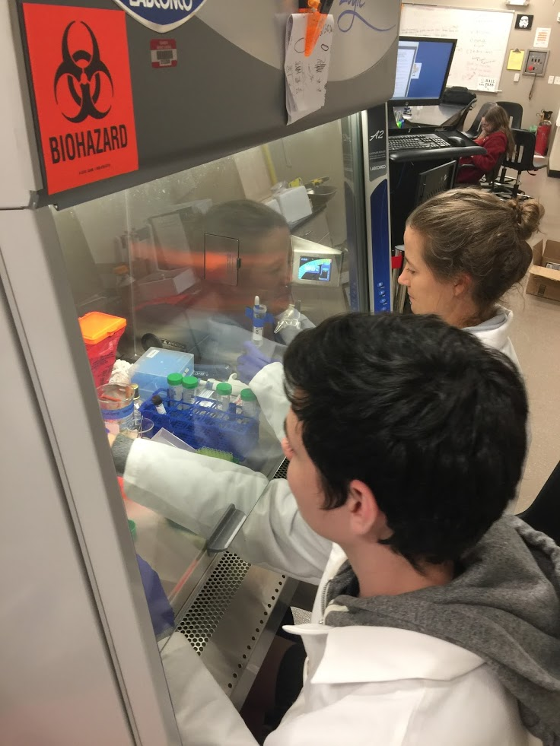
What sets us apart?
Variety of faculty specialties
Microbiology/Cells/Health
Engineering
Physical Sciences
Beyond!
State-of-the-art Lab
Biosafety Level 2 Certified
Only high school in the area able to conduct advanced cell culture & microbio projects
Fundraising = equipment
Ex. Ultrasonicator, Cell culture incubator, and more!

Slide 31
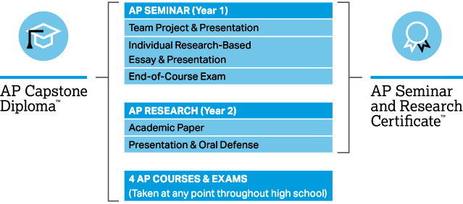
Equivalent of AP Scholar Status!

Slide 32
MaST Course Progression

Slide 33
MaST Course Descriptions
Hon. Exp. Sci. I | Teacher guided introduction to advanced research methods. Study will include scientific skills, all parts of a research project, hands-on experimentation across various STEM areas, and a short-term research project.
AP Seminar | STEM focused class that engages students in conversations that explore the complexities of topics and issues. AP Exam consists of a team project/presentation, individual research-based essay/presentation, and written analysis test.
AP Research | Independent STEM research experimental project with teacher meetings for guidance. Entrance to various paper, poster, and oral competitions. AP Exam consists of 4000-5000 word research paper and oral presentation research defense.
Hon. Exp. Sci. II | Independent STEM research with teacher meetings for guidance. Entrance to various paper, poster, and oral competitions. Senior year culminates in public symposium research defense.

Slide 34
College Acceptances and Awards!
Harvard
Princeton
Duke
Dartmouth
Columbia
Barnard
Georgia Tech
Northwestern
Boston University
Stanford
Brown
Johns Hopkins
Since 1999:
Students have had most county representatives (by far) at INTEL International Science Fair
Since 1995: Most first place prizes (by far) in Regional Science Fair
Each Year: Place Awards at the State Science Fair
Each Year: students selected to speak at JSEHS state conference
Each Year: students selected to speak at FJAS state conference (1st & 2nd Place Last Year!)

Slide 35
Being a MaST Research Scholar sets you apart…
Recognition on diploma and at graduation
Unique “edge” when applying to college
Opportunities each year to participate in prestigious competitions

Slide 36
College Applicants
Good Grades
High SAT/ACT Scores
Something that Stands Out from the Rest

Slide 37
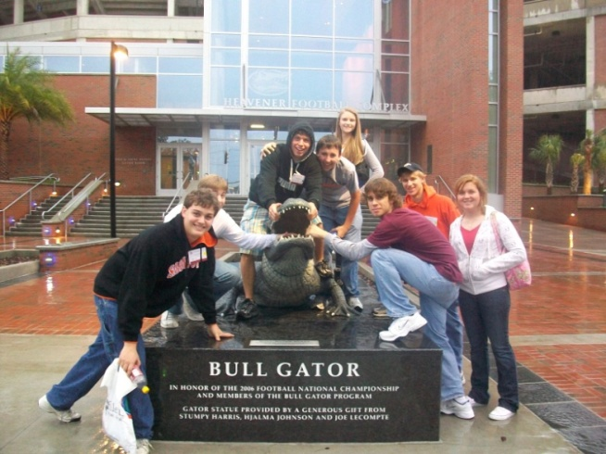
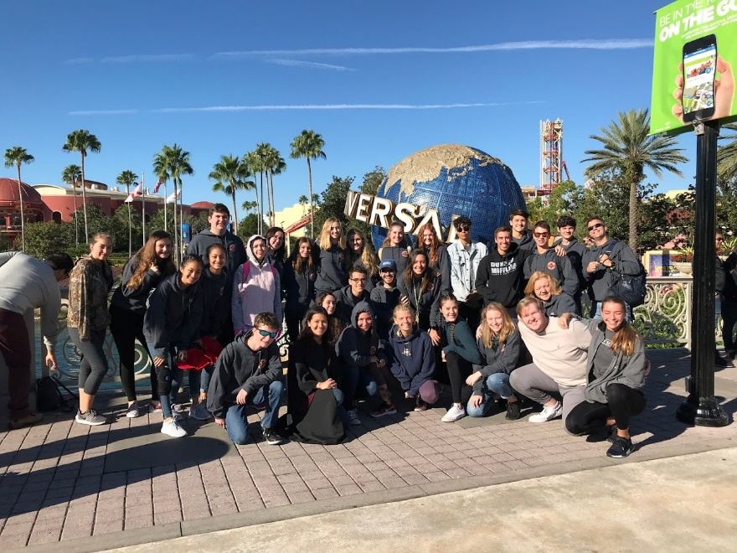
Community Activities
Field Trips
Fundraisers
Booster Organization
Academic competitions
Semester gatherings

Slide 38
How to Apply to MaST
Application Criteria
Passion for Science, Math, and/or Engineering to do college level research
Application (50 student max)
Fill out application online at www.shsmri.com
Due dates: Decisions made end of each month starting in January, May 15 for last chance for non-districted SHS students (if spots remain)
Student Evaluation
Student test scores will be evaluated just as in AICE

Slide 39
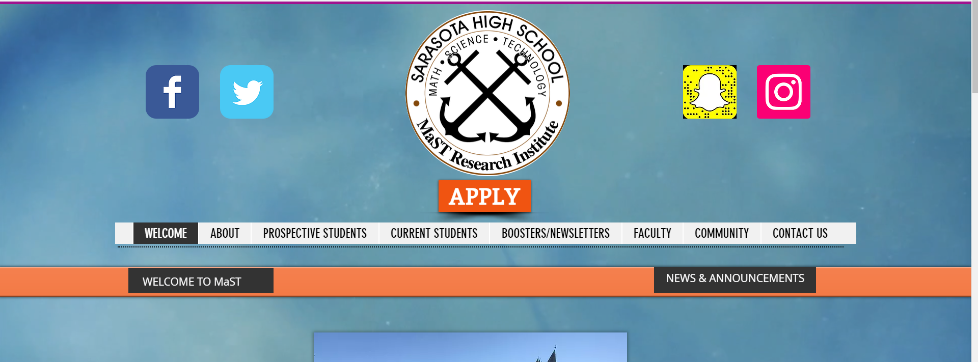
How to Apply to MaST
Visit www.shsmri.com
Click on the “Apply” Button on top
Fill out and submit application form online
We will review records and get back to you within 2 weeks

Slide 40
Students Testimonials

Slide 41
Thank you!

